Slide 1



GÉANT’s Digital Services underlying
the RI ecosystem
Cathrin Stöver
CCO, Géant
RI Conference - Brussels
5 June 2024
Public
Notes:
Dear Cathrin,
On behalf of the e-IRG Chair Stefan Hanslik and e-IRG co-Chair Chris de Loof and the PC for the e-IRG Workshop under the Belgian Presidency of the Council of the Union, with an overarching theme “Sustainable e-Infrastructures for research results valorisation”, we would like to cordially invite you to:
Session 2: Sustaining the role of e-Infrastructures in EOSC and beyond, Wednesday, 5 June 2024, 16:00 - 18:00 CEST
The e-IRG Workshop will take place at the Royal Library of Belgium (KBR) in Brussels as a hybrid event, attached to the Research Infrastructures Conference | Calendar of Belspo meetings | Belgian presidency of the Council of the European Union | Belspo
Session 2 description
The second session of the e-IRG Workshop under Belgian EU Presidency aims to continue the discussions from the Valencia e-IRG Workshop and reflect on the future orientation of Research Infrastructures and its next Work Programme, which includes the topic of sustainability of RIs, and refers to the federation and uptake of e-Infrastructures. The landscape becomes more complex with multiple other funding streams besides the Framework Programmes for Research (currently Horizon Europe), such as the Connecting Europe Facility (CEF Digital), the Digital Europe Programme (DEP), and other national/regional funding instruments, such as the Recovery and Resilience Facility (RRF) fund and the traditional European Structural and Investment Funds. The session will also touch upon the concept of federation and role of e-Infrastructures in the new EOSC node-based ecosystem, especially as e-Infrastructures are not formally part of the nodes' ecosystem nor the EOSC procurement projects. The sustainability topic of RIs and e-Infrastructures is also relevant to the new ERA policy agenda for 2025-2027.
We would like to invite you to contribute to session 2 and to provide a 15-minute presentation about the above-mentioned topics from the perspective of GÉANT and in particular on the coordination of the EU funding streams relevant to e-Infrastructures (exact title to be defined).
The session currently has the following layout:
[Session 2 layout – Titles to be updated]
Future Orientation of the Research Infrastructures Work Programme, (EC and ESFRI-EOSC Task Force), Javier Lopez-Albacete, EC/DG RTD
Coordination of EU funding streams, Cathrin Stoever, GÉANT
The role of e-Infrastructures in the EOSC nodes ecosystemand beyond
NRENs as EOSC nodes and beyond – The Belnet paradigm, Dirk Haex, Belnet
The e-IRG policy document on e-InfrastructuresSustainability,Recommendations on European e-Infrastructures for Research and Education (zenodo.org)
The e-Infrastructure Assembly view(EGI, EUDAT, GÉANT, OpenAIRE, PRACE) – Speaker to be identified
The role of thematic Research Infrastructures in the EOSC nodes ecosystem (Andy Goetz, ESFRI-EOSC TF/EOSC-A)
Panel discussion
Further information about the e-IRG Workshop under the BelgianPresidency of the Council of the Union can be found at: e-IRG Workshop under Belgian EU Presidency (5 June 2024): Overview
We are looking forward hearing from you and seeing you in Brussels.
All the best,

Slide 2


Slide 3
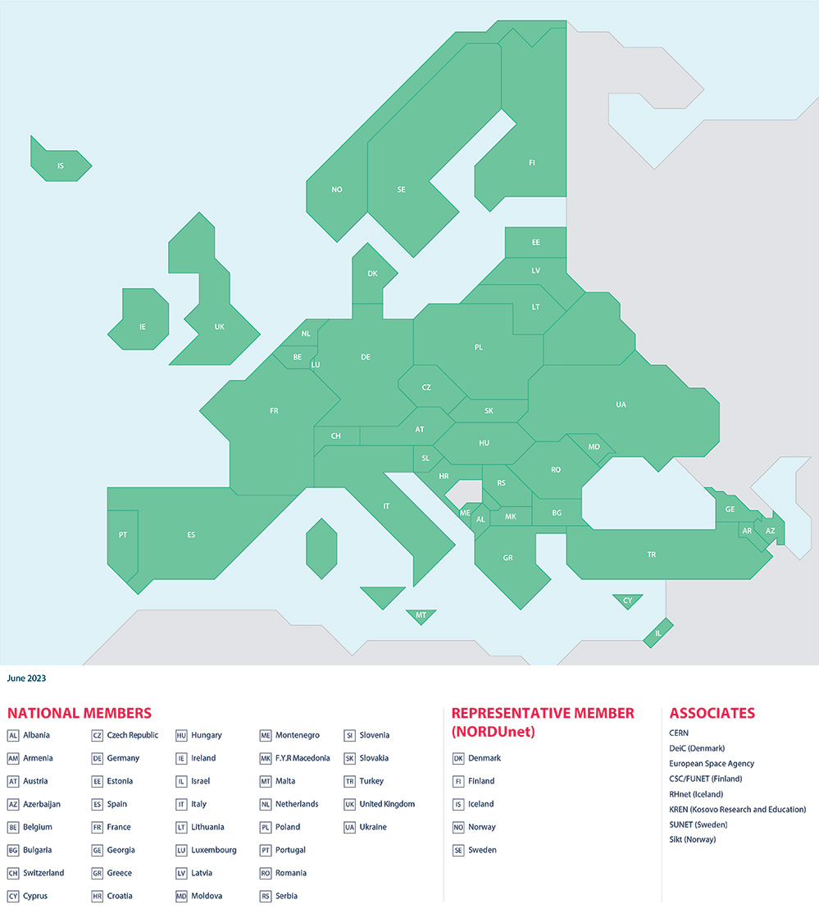


GÉANT – a Bottom-Up Membership Association since 1993
We represents 38 NRENs and NORDUnet across Europe.
Together we support over 10,000 institutions and 50 million academic users.
Notes:
Alternative slide using map

Slide 4
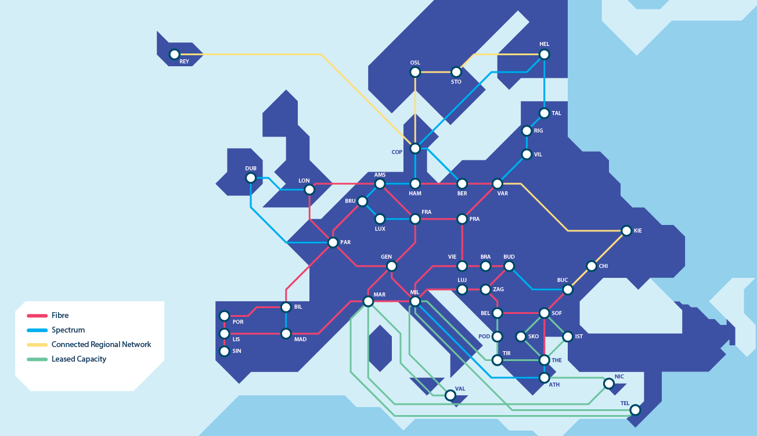
Fibre capacity for the European Research Area. The GÉANT Network is Terabit ready.

Slide 5



















2004
2011
TEIN2
EUMEDCONNECT3
AfricaConnect
2016
2001
2009
2013
2020
2022
CAREN
Asi@Connect managed by TEIN*CC
BELLA-T managed by RedCLARA
EUMEDCONNECT
CAREN2
EaPConnect2
BELLA-II managed by RedCLARA
2003
2008
2012
2015
2019
2021
2023
ALICE
EUMEDCONNECT2
TEIN3
ALICE2 managed by (Red)CLARA
TEIN4 managed by TEIN*CC
CAREN3
AfricaConnect2
EaPConnect
AfricaConnect3
CAREN3 ends
EUMEDCONNECT3 ends
Medusa
>20 Years of Building R&E networks globally

Slide 6
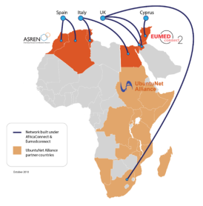
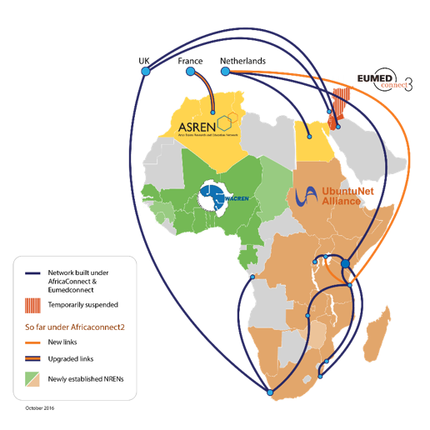
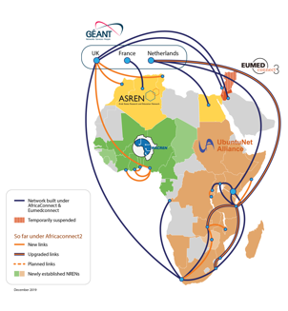
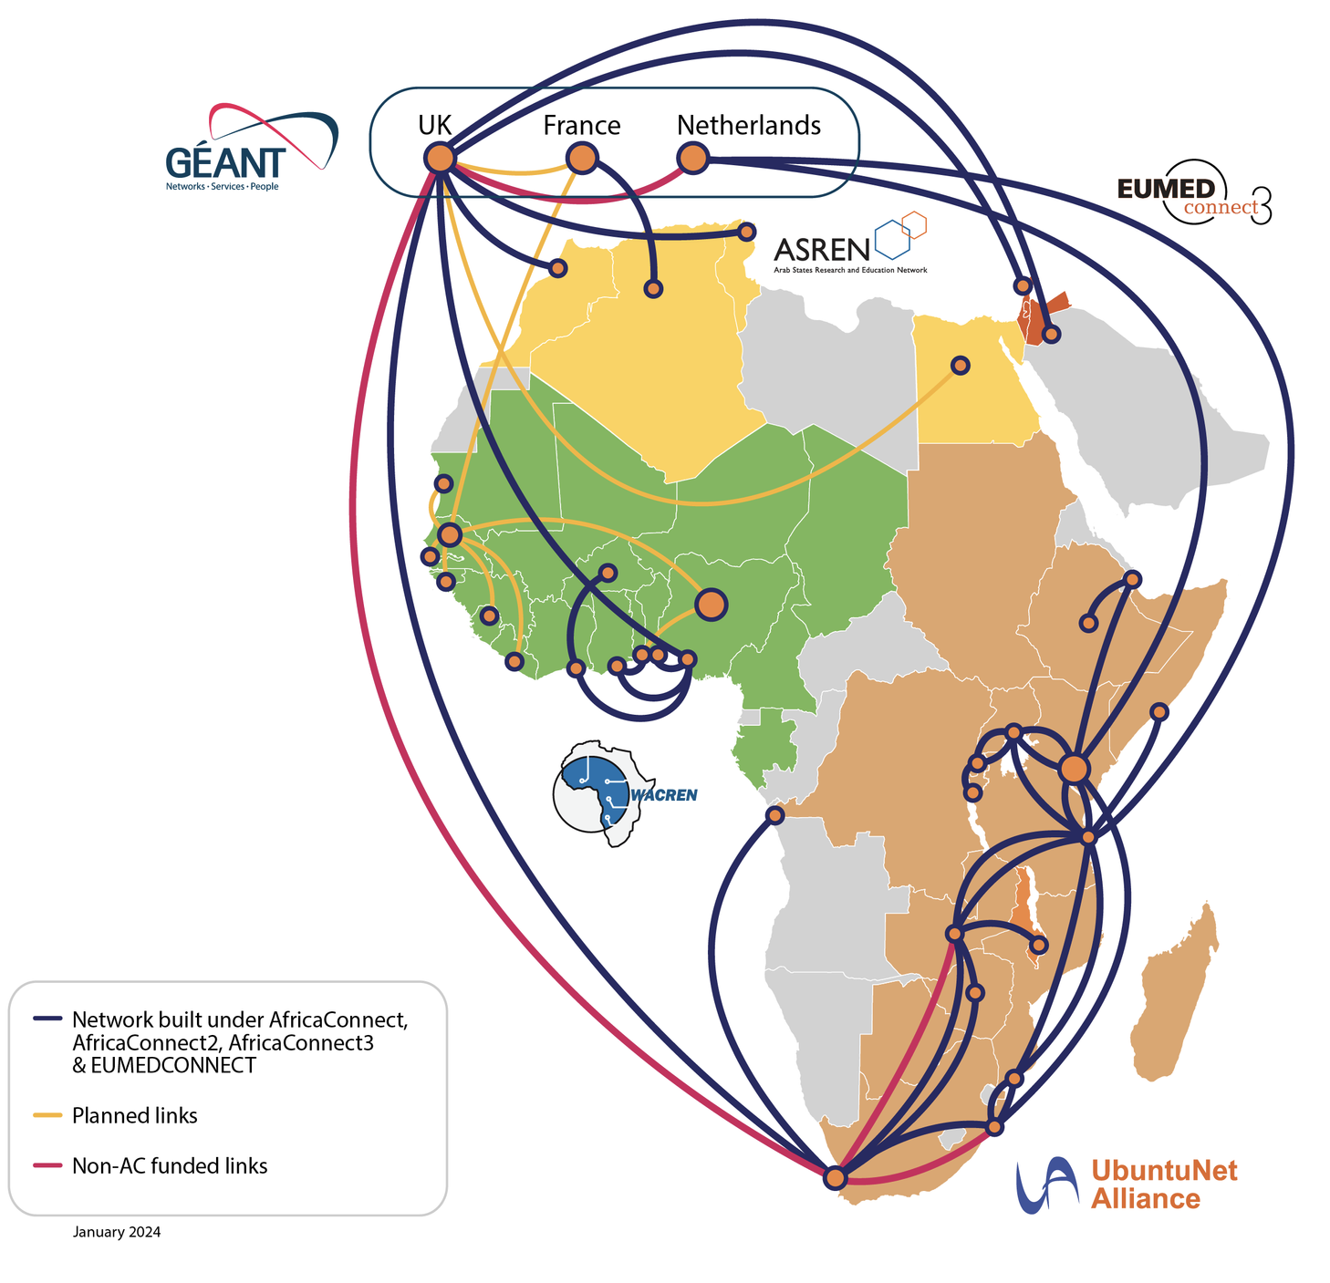
Connectivity of NRENs in Africa
Before
AfricaConnect - 2010
5 Countries Connected
End of
AfricaConnect1 -2015
9 Coutries connected
End of
AfricaConnect2 -2019
19 countries connected
Since AfricaConnect started in 2011, 23 out of 38 African NRENs have been connected to their regional network:
UbuntuNet Alliance 13: Botswana, Burundi, DRC, Kenya, Malawi, Mozambique, Rwanda, Somalia, South Africa, Tanzania, Uganda, Zambia and Zimbabwe.
WACREN 6: Ghana, Nigeria and Togo, Benin, Burkina Faso and Côte d’Ivoire.
ASREN 4: Algeria, Egypt, Morocco and Tunisia.
Ethiopia to be connected in 2024
Tender started to connect more countries in West Africa.
www.africaconnect3.net

Slide 7
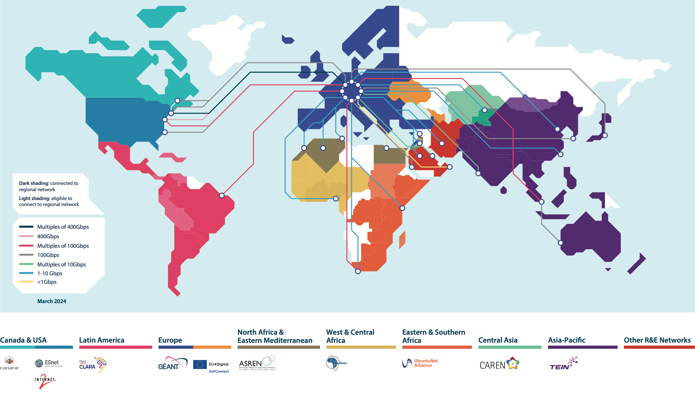

Slide 8

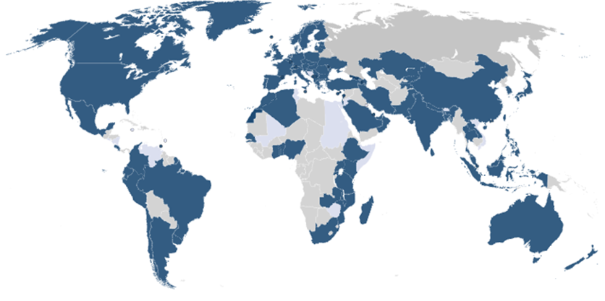
eduroam Service uptake:
National Roaming Operators (NROs)
>104
Countries
10,000+
Institutions
38,400+
Service
Locations
Member
Pilot
Possible new regions to ‘eduroam-ise’

Slide 9
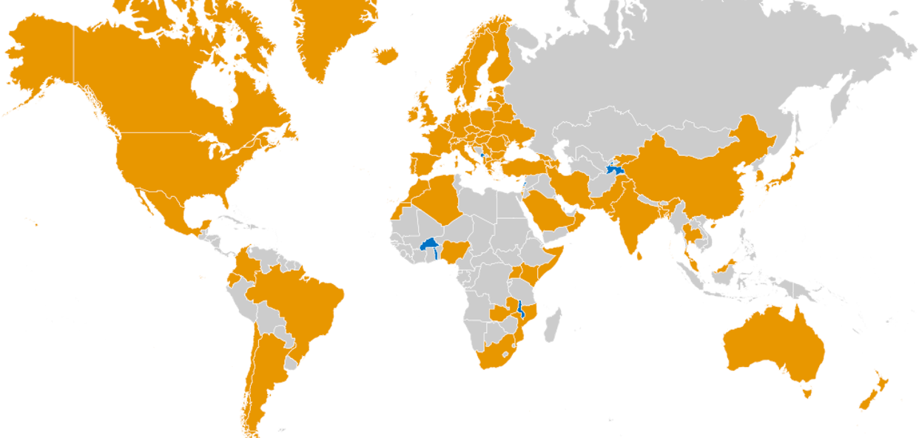

The growth of eduGAIN federations
79
Countries
5,600+
Institutions
3,000+
Service
Locations
edugain.org

Slide 10
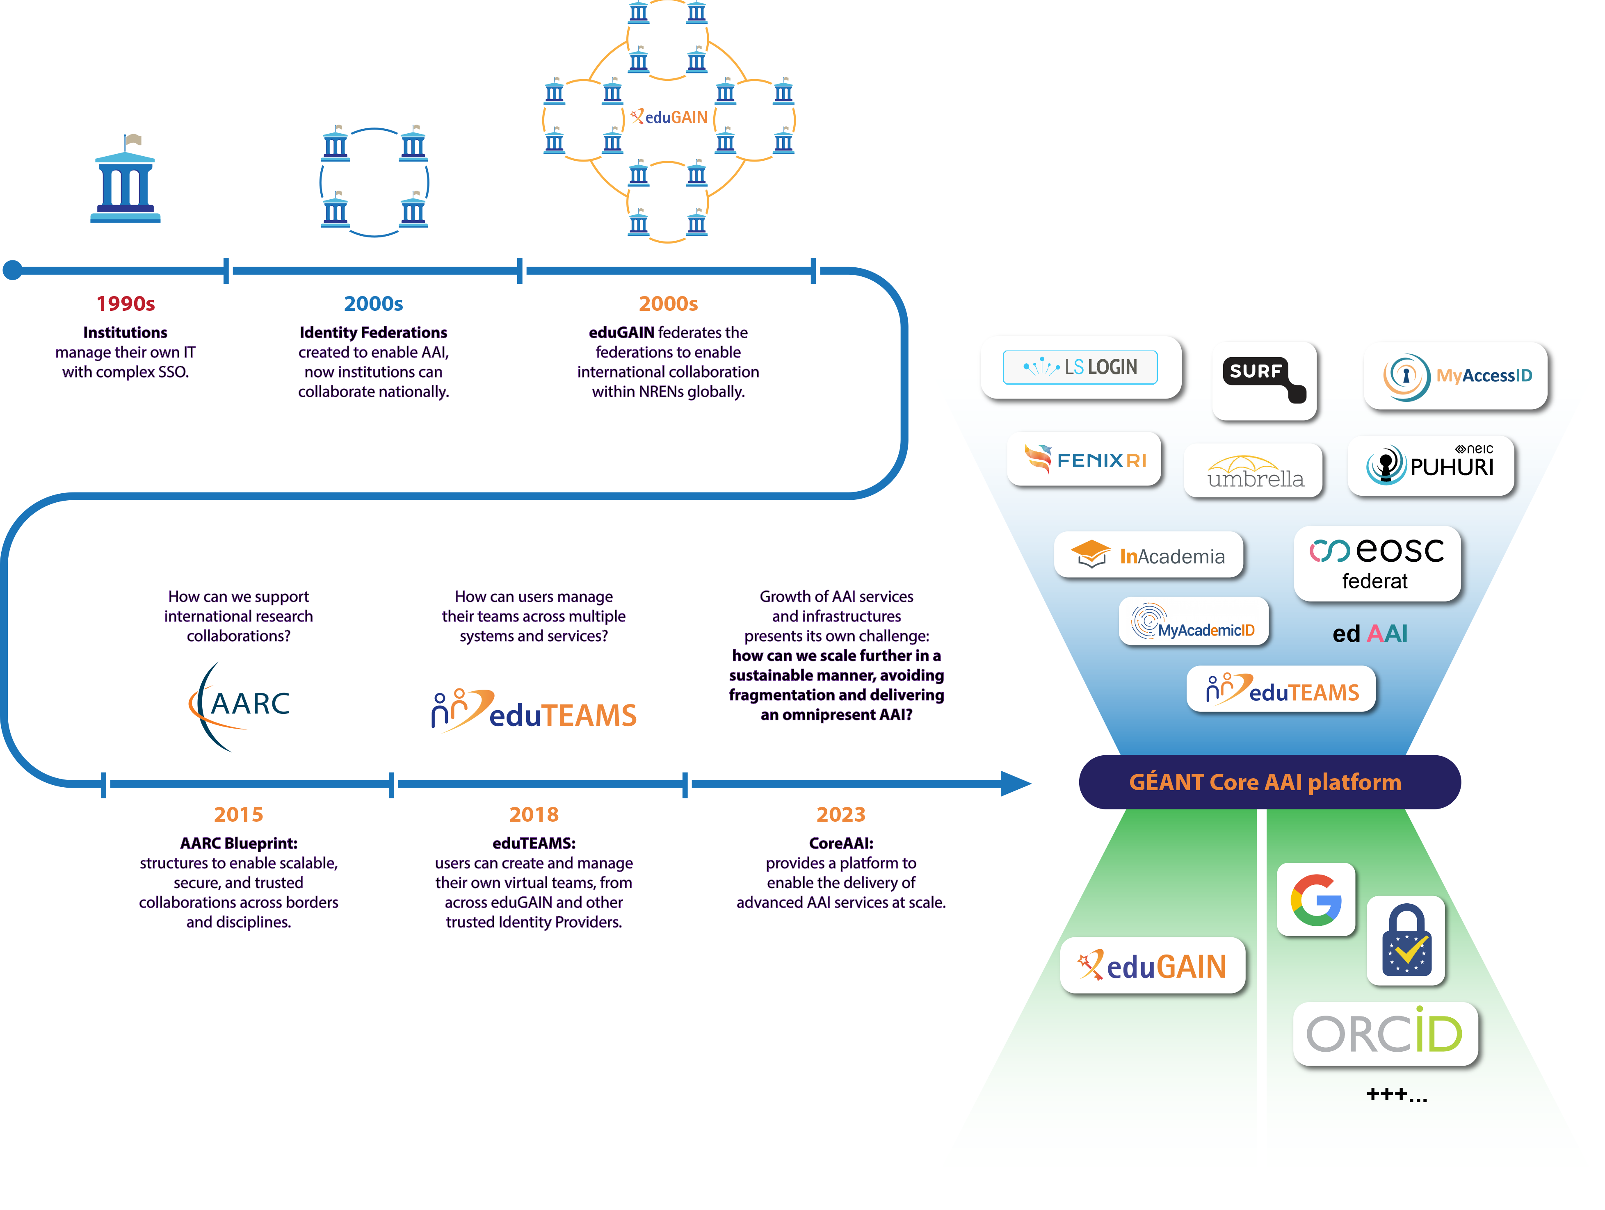
Trust and Identity Services for the European Research Community
Adapating T&I Services to ever complex needs.

Slide 11













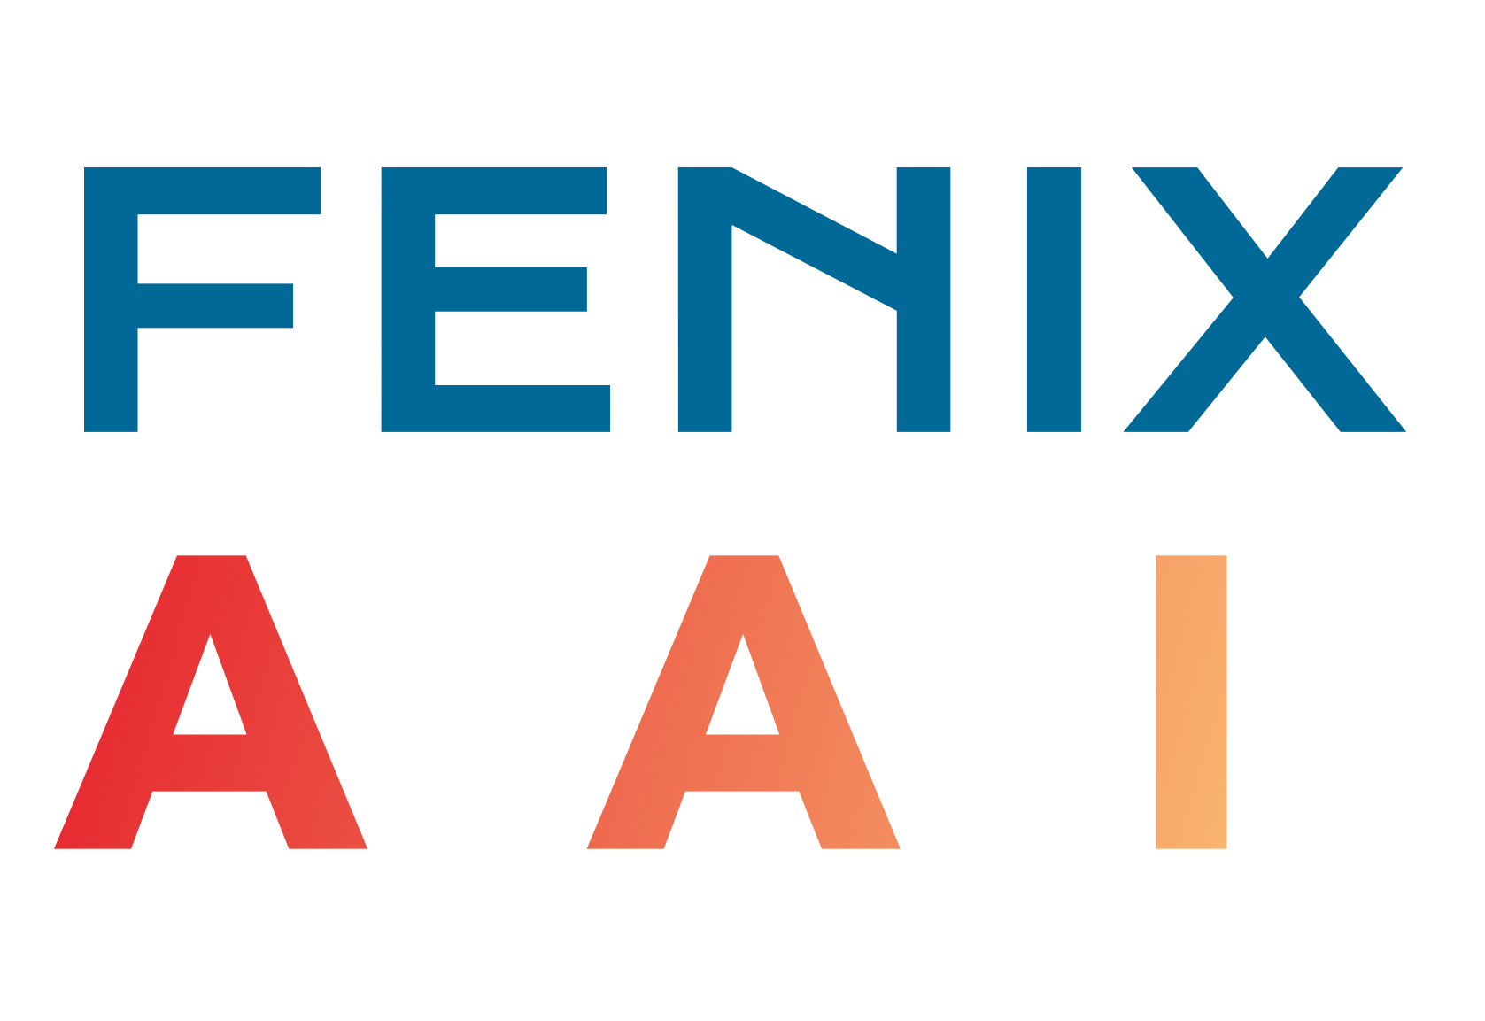


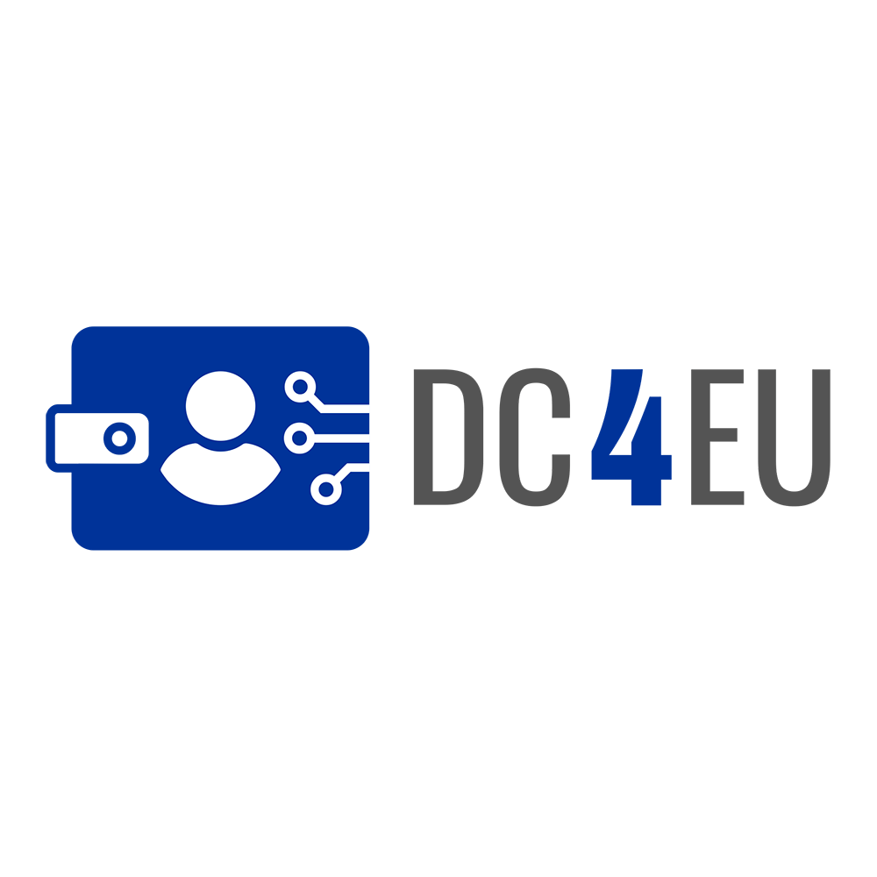















































GEANT
NREN
Infrastructures
High
Performance
Computing
European
Research
Infrastructures
Education
COMMUNITY
2024
EUDI
Wallet
AAI Services
federated AAI
GEANT
AAI SERVICE
Core AAI Platform
Third Party
NREN

Slide 12
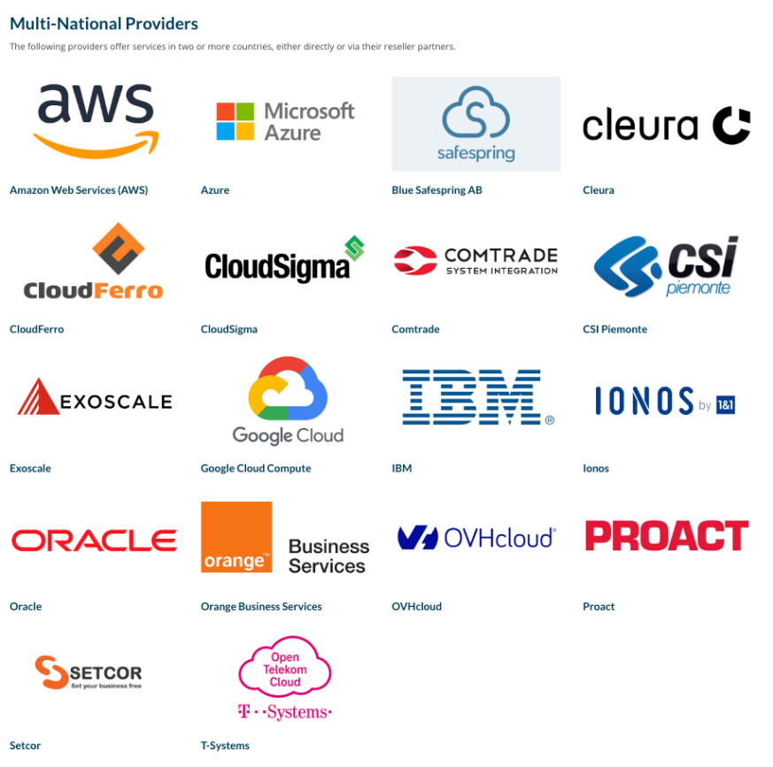
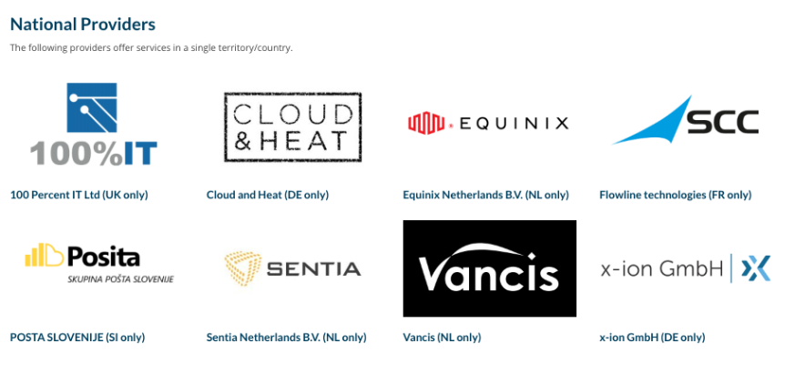

GÉANT Cloud Frameworks
Now at their second iteration and actively procuring the third one, the flagship GÉANT Cloud Framework agreements (IaaS 2016, IaaS+ aka OCRE 2020, OCRE 2024), enable easy, agile and compliant access to a broad and varied portfolio of commercial cloud services, while reducing costs and bureaucratic burdens.
Who is benefitting from
GÉANT Cloud Frameworks?
Current service providers (OCRE 2020) – 469 framework services
>900 R&E Institutions
In 28 Countries
30% increase
in consumption Year on Year

Slide 13

Thank you!
Any questions?
cathrin.stover@geant.org
www.geant.org

